Slide 2
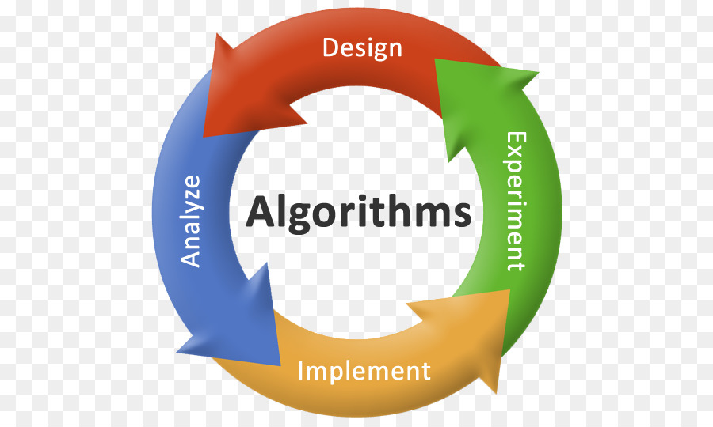
Algorithms
An algorithm is a set of rules that specify the order and kind of arithmetic operations that are used on a specified set of data.
An algorithm is an effective method expressed as a finite list of well-defined instructions for calculating a function.
An algorithm is a finite, definite, effective procedure, with some output
Systematic procedure that produces – in a finite number of steps –
the answer to a question or the solution of a problem.

Slide 3
Essential properties of an algorithm
an algorithm is finite (w.r.t.: set of instructions, use of resources, time of computation)
instructions are precise and computable
• instructions have a specified logical order, however, we can discriminate between
deterministic algorithms (every step has a well-defined successor)
non-deterministic algorithms (randomized algorithms, e.g.)

Slide 4
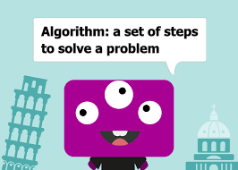
Basic Questions About Algorithms
For each algorithm, we should answer the following basic questions:
• does it terminate?
• is it correct?
• is the result of the algorithm determined?
• how much resources will it use in terms of
• memory? (and memory bandwidth?) • operations?
• run-time

Slide 5
Swapping Two Numbers Using Variable
In many case, programmers are required to swap values of two variables. Here, we shall learn how to swap values of two integer variables, that may lead to swapping of values of any type. Values between variables can be swapped in two ways −
With help of a third (temp) variable
Without using any temporary variable

Slide 6

Swapping Two Numbers Using Variable With help of a third (temp) variable
Logic:
Suppose we take two values in a and b, a=10, b=20 respectively.
temp=a;
a=b;
b=temp;
After the operation of this statement, the value of two variable a and b will be interchanged.
Output:
A=20, B=10;

Slide 7
Algorithm:
Using the temporary variable
Step 1: Start
Step 2: Take the value of variables a and b.
Step 3: Assign the value of variable a into the temp variable.
Step 4: Assign the value of variable b into a variable.
Step 5: Assign the value of variable temp into the b variable.
Step 6: Print the value of a and b.
Step 7: Stop

Slide 8
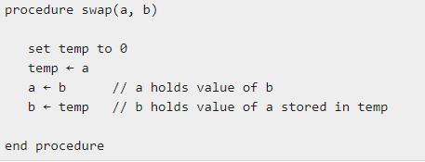
Pseudocode
Using the temporary variable

Slide 9
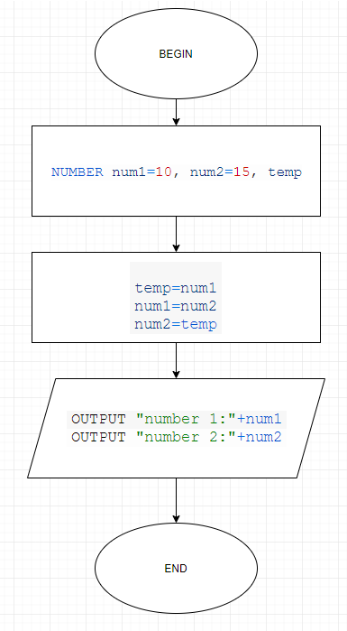
Flow Chart

Slide 10
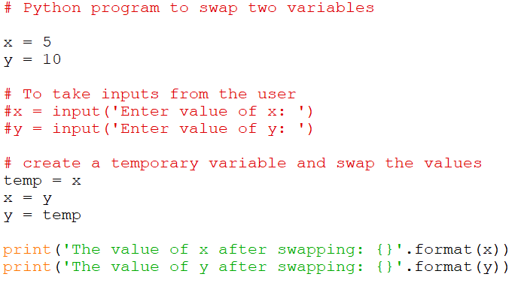
Python Program

Slide 11
Swapping Two Numbers without Using Variable
Here we will use arithmetic operator (+, -). We use addition and subtraction operation on these variables.
a=a+b;
b=a-b;
a=a-b;

Slide 12
Algorithm:
Without Using the temporary variable
Step 1: Start
Step 2: Take the value of variables a and b.
Step 3: Add the values of the a and b and assign it to the variable a.
Step 4: Subtract the values of a and b and assign it to the variable b. (Here the value of a is changed due to the step 3).
Step 5: Subtract the values of a and b and assign it to the variable a.
Step 6: Print the value of a and b.
Step 7: Stop

Slide 13
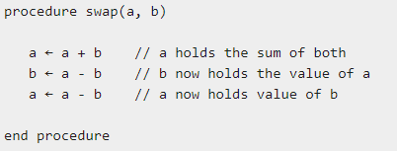
Pseudocode
Without Using the temporary variable

Slide 14
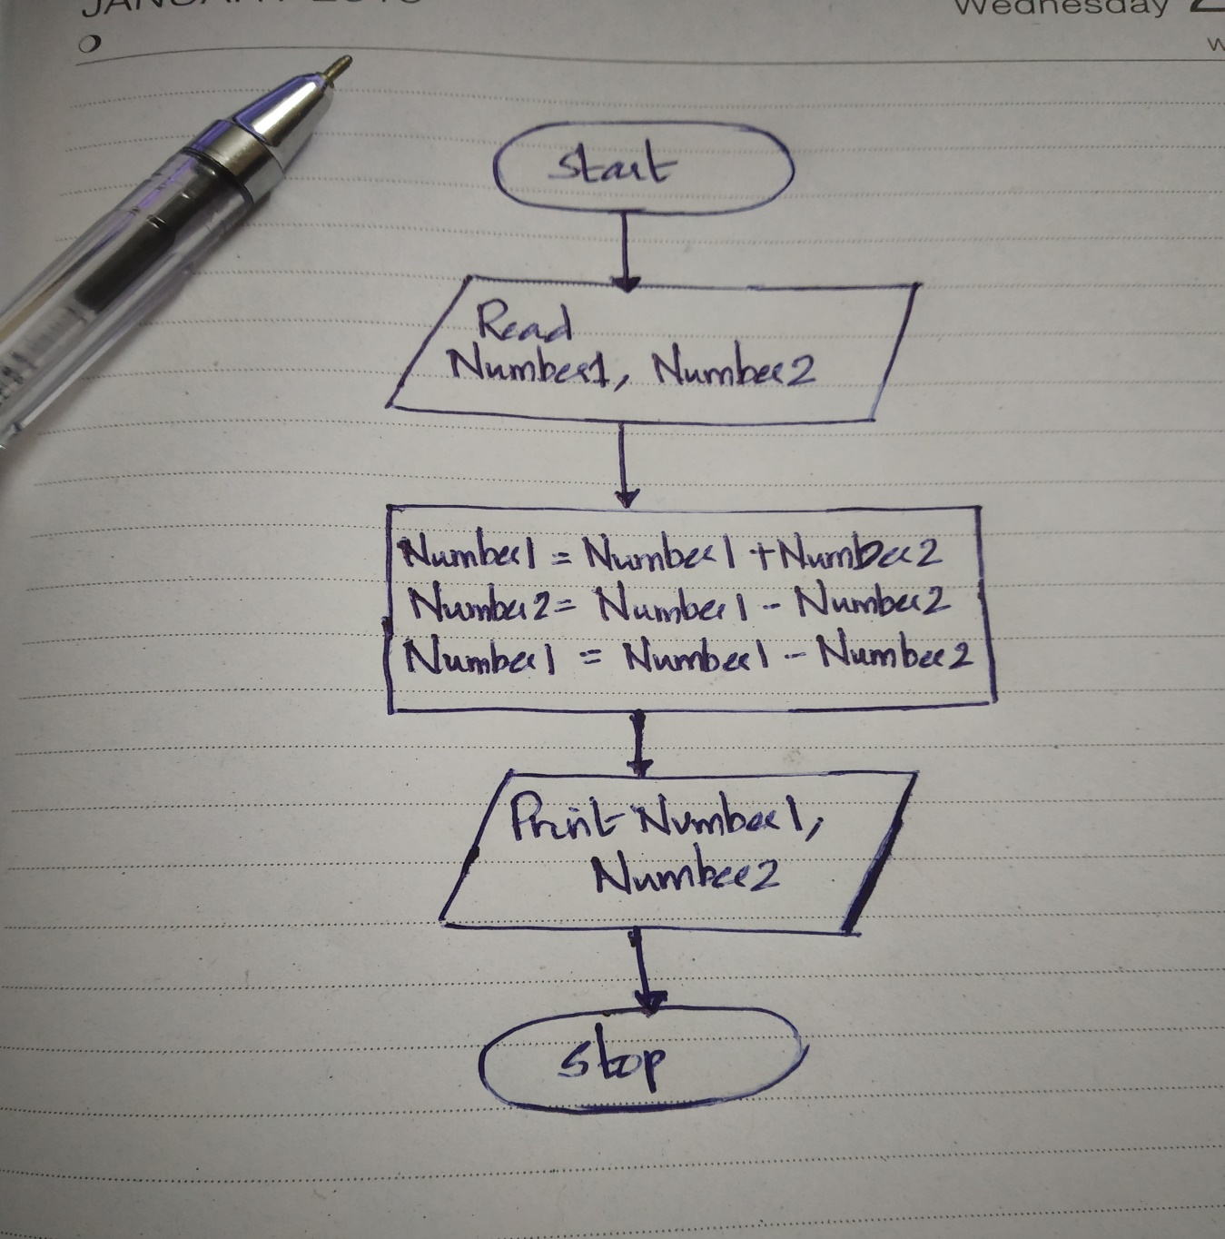
Flow Chart

Slide 15
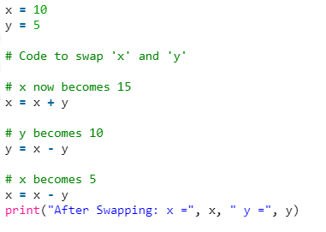
Python Program

Slide 16
Without using third variable and without using arithmetic operator
Here we will use the Exclusive OR bit-wise operator.
Logic:
a=a^b;
b=a^b;
a=a^b;

Slide 17
Algorithm:
Without Using the temporary variable
Step 1: Start
Step 2: Take the value of variables a and b.
Step 3: Operate Exclusive OR operation on variable a and b and assign the exclusive OR output in a variable. (Here value of a is changed)
Step 4: Operate Exclusive OR operation on variable a and b and assign the exclusive OR output in b variable. (Here value of b is changed)
Step 5: Operate Exclusive OR operation on variable a and b and assign the exclusive OR output in a variable. (Here value of a is again changed)
Step 6: Print the value of a and b.
Step 7: Stop

Slide 18
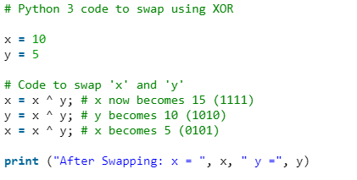
Python Program

Slide 19
Program to count digits in an integer
The integer entered by the user is stored in variable n. Then the while loop is iterated until the test expression n != 0 is evaluated to 0 (false).
After first iteration, the value of n will be 345 and the count is incremented to 1.
After second iteration, the value of n will be 34 and the count is incremented to 2.
After third iteration, the value of n will be 3 and the count is incremented to 3.
At the start of fourth iteration, the value of n will be 0 and the loop is terminated.

Slide 20
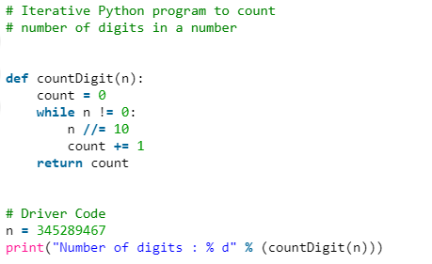
Program to count digits in an integer
Method 1

Slide 21
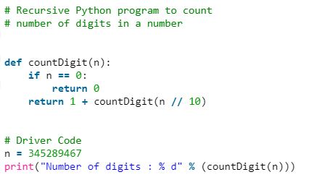
Program to count digits in an integer
Method 2

Slide 22
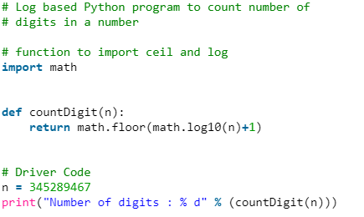
Program to count digits in an integer
Method 3

Slide 23
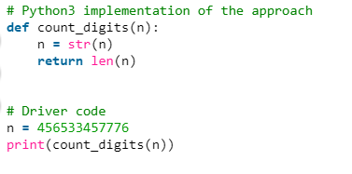
Program to count digits in an integer
Method 4

Slide 24
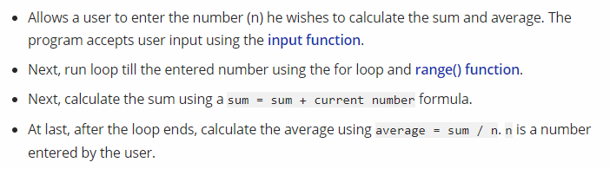
Algorithm: calculate the sum and average of first n natural numbers

Slide 25
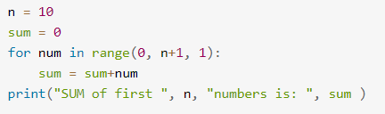
Python Program to calculate the Sum

Slide 26
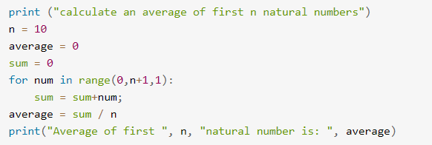
Python Program to calculate average

Slide 27
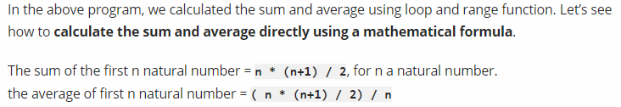
Calculate the sum and average of first n natural numbers using formula

Slide 28
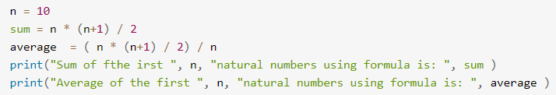
Calculate the sum and average of first n natural numbers using formula

Slide 29
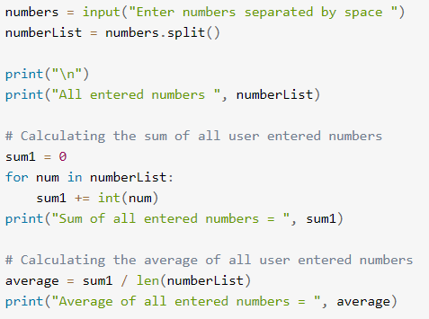
Calculate the sum and average of multiple user-entered numbers

Slide 30
Calculate the sum and average of multiple user-entered numbers

Slide 31
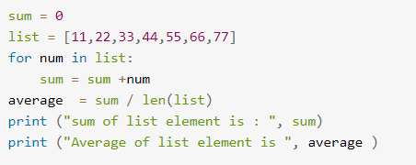
Calculate the sum and average of multiple user-entered numbers

Slide 32
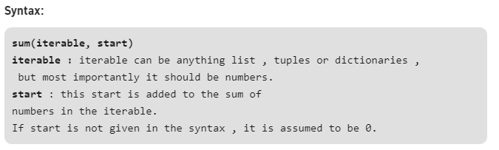
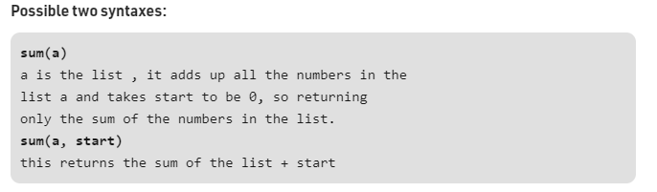
Calculate sum using the built-in sum function in Python
Sum of numbers in the list is required everywhere. Python provide an inbuilt function sum() which sums up the numbers in the list

Slide 33
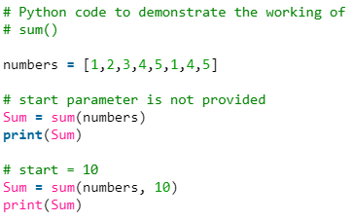
sum() function in Python

Slide 34
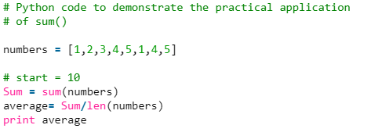
sum() function in Python
Practical Application: Problems where we require sum to be calculated to do further operations such as finding out the average of numbers.

Slide 35
Factorial Computation

Slide 36
Algorithm to calculate factorial value of a number
step 1. Start step 2. Read the number n step 3. [Initialize] i=1, fact=1 step 4. Repeat step 4 through 6 until i=n step 5. fact=fact*i step 6. i=i+1 step 7. Print fact step 8. Stop

Slide 37
Fibonacci Sequence

Slide 38
Algorithm to print Fibonacci series up to given number N
Step 1: Start
Step 2: Declare variables N, N1, N2, N3, i.
Step 3: Read value of N from user.
Step 4: if N < 2, display message “Enter number > 2” and go to step 9.
Step 5: Initialize variables N1 = 0, N2 = 1, i = 0
Step 6: Display N1, N2
Step 7: Compute N3 = N1 + N2
Step 8: Repeat following statements until i < N - 2
Display N3
N1 = N2
N2 = N3
N3 = N1 + N2
i = i + 1
Step 9: Stop

Slide 39
Reverse a Number

Slide 40
Algorithm to Reverse a Number
Step 1:Start
Step 2:Intilize reverse=0
Step 3:Read digit
Step 4:check whether digit>0 then go to step 5 else go to step 9
Step 5:reverse=reverse*10
Step 6:reverse=reverse+digit%10
Step 7:digit=digit/10
Step 8: Go to step 4
Step 9:Print reverse
Step 10: Stop

Slide 41
Base Conversion
Decimal to Any Base
Decimal to Octal
Decimal to Binary
Decimal to Hexadecimal
Binary to Any Base
Octal to any base
Hexadecimal to any base

Slide 42
The Basic Idea
The basic algorithm for this conversion is to repeatedly divide (integer division) the given decimal number by the target base value until the decimal number becomes 0.
The remainder in each case forms the digits of the number in the new base system, however, in the reverse order.

Slide 43
An Upper Limit
The algorithm, in general, will work for any base, but we need digits/characters to represent that many numbers of a base system.
For simplicity, we limit ourselves to base 36 i.e 10 numbers + 26 alphabets.
(We can differentiate lower and upper case, but we intend to focus on the algorithm here!).
It will be clear after the implementation that the method has to work for any base.

Slide 44
Decimal to Base_{x}
Divide the decimal number by the radix of the target base
The remainder from step 1 becomes the value for the current column.
Use the quotient (answer) from step 1 as the decimal value to calculate the next column.
Return to step 1 and repeat until the quotient is zero.

Slide 45
Example – Decimal to Binary
Let's return to the number 237 and convert it to a binary number:
decimal: |  | 237
radix: |  | 2
Decimal |  | Radix |  | Quotient |  | Remainder
237 | / | 2 |  | 118 |  | 1 (2⁰)
118 | / | 2 |  | 59 |  | 0 (2¹)
59 | / | 2 |  | 29 |  | 1 (2²)
29 | / | 2 |  | 14 |  | 1 (2³)
14 | / | 2 |  | 7 |  | 0 (2⁴)
7 | / | 2 |  | 3 |  | 1 (2⁵)
3 | / | 2 |  | 1 |  | 1 (2⁶)
1 | / | 2 |  | 0 |  | 1 (2⁷)
binary: |  | 11101101

Slide 46
Example – Decimal to Hexadecimal
decimal: |  | 3,134,243,038
radix: |  | 16
Decimal |  | Radix |  | Quotient |  | Remainder
3,134,243,038 | / | 16 |  | 195,890,189 |  | E (14) (16⁰)
195,890,189 | / | 16 |  | 12,243,136 |  | D (13) (16¹)
12,243,136 | / | 16 |  | 765,196 |  | 0 ( 0) (16²)
765,196 | / | 16 |  | 47,824 |  | C (12) (16³)
47,824 | / | 16 |  | 2,989 |  | 0 ( 0) (16⁴)
2,989 | / | 16 |  | 186 |  | D (13) (16⁵)
186 | / | 16 |  | 11 |  | A (10) (16⁶)
11 | / | 16 |  | 0 |  | B (11) (16⁷)
hexadecimal: |  | xBAD0C0DE

Slide 47
Decimal to Any Base – Python Implementation
def dec_to_base(num,base): #Maximum base - 36
base_num = ""
while num>0:
dig = int(num%base)
if dig<10:
base_num += str(dig)
else:
base_num += chr(ord('A')+dig-10) #Using uppercase letters
num //= base
base_num = base_num[::-1] #To reverse the string
return base_num

Slide 48
Base_{x} to Decimal
Actually, I have already demonstrated how to convert a number from a base different than ten, into decimal. Once again, here is the complete formula, where c_{x} represents the coefficients at each place-column.
c_{n}·b^{n} + ... + c₂·b² + c₁·b¹ + c₀·b⁰
As an example, let's convert the binary answer back into decimal:
1·2⁷ + 1·2⁶ + 1·2⁵ + 0·2⁴ + 1·2³ + 1·2² + 0·2¹ + 1·2⁰
1·128 + 1·64 + 1·32 + 0·16 + 1·8 + 1·4 + 0·2 + 1·1
128 + 64 + 32 + 8 + 4 + 1
237

Slide 49
Base_{x} to Base_{y}
Is it possible to convert a number from Base_{x} directly to Base_{y} without converting to decimal (base-10) first?
Yes, however, you will need to perform all of your math operations in either Base_{x} or Base_{y}. The algorithms that I have presented are performed with base-10 since that is the number system most people are familiar with.

